Slide 1

Introduction to Supervised Machine Learning

Slide 2

Did you know
First Neural Network was invented in 1958
Psychologist Frank Rosenblatt
Named ‘Perceptron’
Intended to model the human brain
Notes:
One interesting fact

Slide 3
What is Machine Learning
“Field of study that gives the computers the ability to learn without being explicitly programmed.”
- Arthur Samuel 1959
ML models rely on hidden patterns and inference
Instead of writing a program, we teach the algorithm to learn by feeding it data samples
Notes:
Samuel was an American pioneer in the field of computer gaming and AI
He popularized the term machine learning

Slide 4
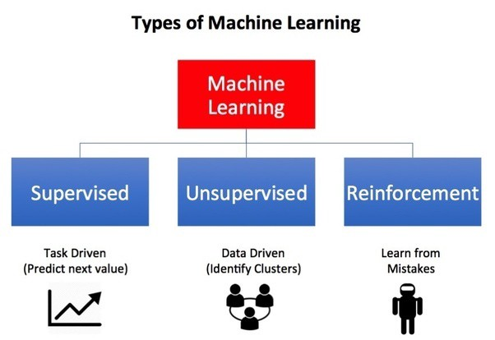
Types of Machine Learning
Notes:
Supervised Learning
Learns patterns from tagged data
There is a target
Function map inputs -> Outputs
Continuous Real Value and Class
Pricing Models | Customer Retention Models
Unsupervised Learning
Learns patterns from untagged data
There is no target variable
Principal Component Analysis and Cluster Analysis
Dimensionality Reduction Recommender Systems & Targeted Marketing
Reinforcement Learning
Doesn’t need labeled inputs/output data pairs
Models are based on a game-like situation (Trials and Error)
Uses exploration and exploitation as a learning mechanism
Typically reinforcement algorithms work based on a reward/Penalty system
Goal is to maximize the total reward
Normally used in robotics and gaming

Slide 5
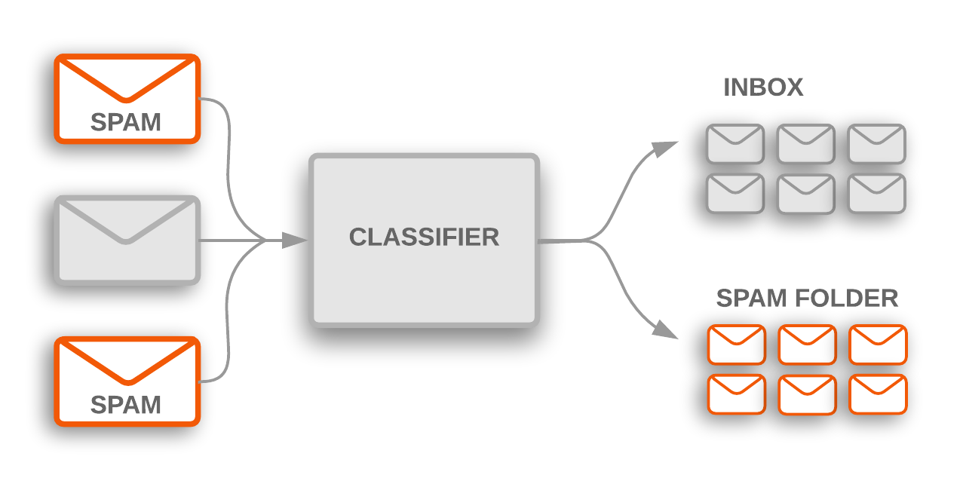
Supervised Learning
Spam Detector:
Input
Output
ML Model
Notes:
Arthur Samuel defined Machine Learning as
“Field of study that gives the computers the ability to learn without being explicitly programmed.”
ML algorithms help computers learn from the data
They can detect very highly complex patterns
They create their own rules

Slide 6
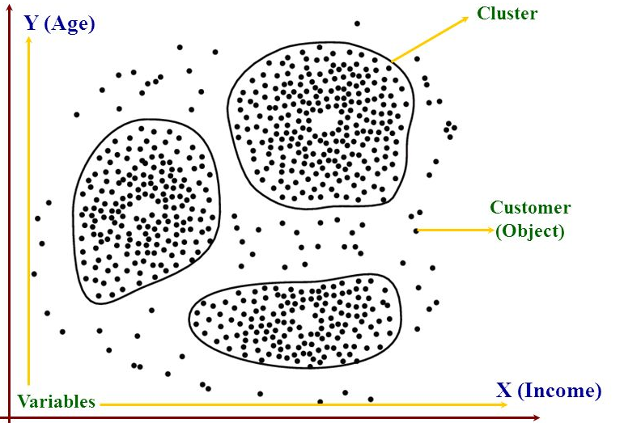
Unsupervised Learning
Product B
Product C
Product A
Notes:
Supervised Learning
Learns patterns from tagged data
There is a target
Function map inputs -> Outputs
Continuous Real Value and Class
Pricing Models | Customer Retention Models
Unsupervised Learning
Learns patterns from untagged data
There is no target variable
Principal Component Analysis and Cluster Analysis
Dimensionality Reduction Recommender Systems & Targeted Marketing
Reinforcement Learning
Doesn’t need labeled inputs/output data pairs
Models are based on a game-like situation (Trials and Error)
Uses exploration and exploitation as a learning mechanism
Typically reinforcement algorithms work based on a reward/Penalty system
Goal is to maximize the total reward
Normally used in robotics and gaming

Slide 7
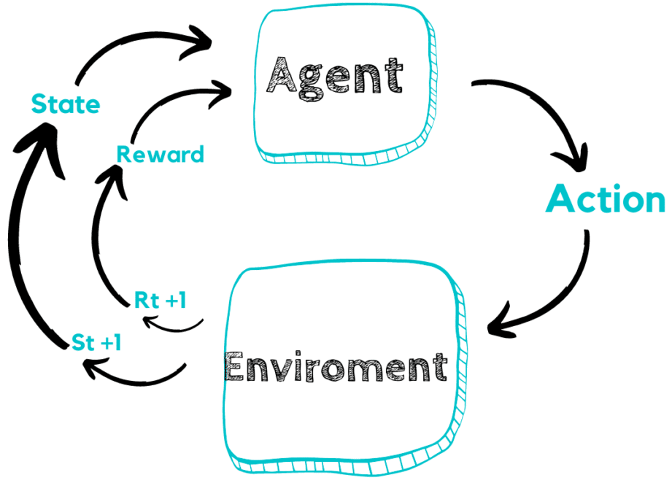
Reinforcement Learning
Notes:
Supervised Learning
Learns patterns from tagged data
There is a target
Function map inputs -> Outputs
Continuous Real Value and Class
Pricing Models | Customer Retention Models
Unsupervised Learning
Learns patterns from untagged data
There is no target variable
Principal Component Analysis and Cluster Analysis
Dimensionality Reduction Recommender Systems & Targeted Marketing
Reinforcement Learning
Doesn’t need labeled inputs/output data pairs
Models are based on a game-like situation (Trials and Error)
Uses exploration and exploitation as a learning mechanism
Typically reinforcement algorithms work based on a reward/Penalty system
Goal is to maximize the total reward
Normally used in robotics and gaming

Slide 8
Types of Machine Learning
Supervised algorithm:
Classification – Predicting a discrete variable
Regression – Predicting a continuous variable
Examples:
Email Spam (Google)
Home Value Prediction (Zillow)
Fraud Detection (Capital One)
Customer Retention (AT&T)
Notes:
Classification: A classification problem is when the output variable is a category, such as “red” or “blue” or “disease” and “no disease”.
Regression: A regression problem is when the output variable is a real value, such as “dollars” or “weight”.

Slide 9
Team Exercise
Predict…
the MPG of a vehicle
whether it will rain today
the age of a person
the nationality of a person
if stock price of a company will increase tomorrow
the gender of a person by their handwriting style
house price based on area
the number of copies an album will sell next month

Slide 10
Classification
The output variable is a category
Typical ML algorithms:
Logistic Regression
k-Nearest Neighbors
Decision Tree Classification
Support Vector Machine
Naive Bayes
Notes:
Logistic Regression: Non-Linear algorithm that determines classification by probability [0,1]
k-Nearest Neighbors – Distance based algorithm
Decision Trees -
Support Vector Machine
Naive Bayes

Slide 11
Regression
When the output variable is a continuous value, such as “dollars” or “weight”.
Typical Linear ML algorithms:
Linear Regression
Lasso/Ridge Regression (Regularization)
Typical Non-Linear ML algorithms:
Decision Tree Regression
Support Vector Regression
Notes:
Linear Regression
Lasso/Ridge Regression (Regularization)
Decision Tree Based
Each model will have a different cost function

Slide 12
Supervised Training
In order to train an ML model, you need:
Understand the problem
Good Data
Define your parameters
“Garbage In Garbage Out”
Notes:
Understand the problem:
If you don’t understand the problem, then you will not know what ML model to apply to a situation
Data:
You need to know your data: EDA, biased, unbalanced
Define Parameters;
Even with good data and a good model, if your model is not properly tuned the results will be incorrect

Slide 13
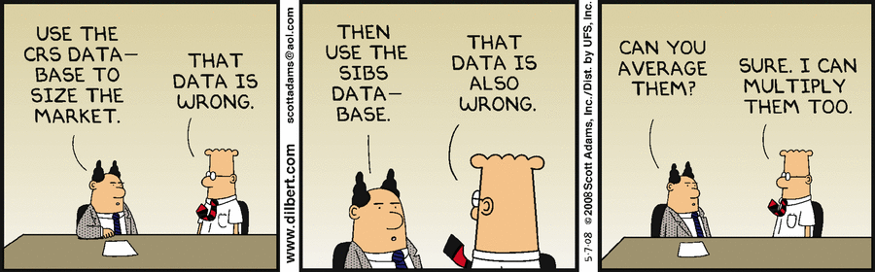
Supervised Training

Slide 14
Supervised Training
In order to train an ML model, you need:
Understand the problem
Good Data
Define your parameters
y
X
Number of Cylinders | Number of Seats | Number of Doors | MPG
4 | 5 | 4 | 25
8 | 7 | 4 | 18
6 | 6 | 2 | 20
5 | 4 | 4 | 18
6 | 5 | 2 | 18
8 | 7 | 4 | 16
Notes:
Linear Regression
Lasso/Ridge Regression (Regularization)
Decision Tree Based
Good data means balanced, consistency, minimize human error, etc.
EDA, data preparation, etc.

Slide 15
Supervised Training
What other features could we consider for the problem below?
y
X
Number of Cylinders | Number of Seats | Number of Doors | MPG
4 | 5 | 4 | 25
8 | 7 | 4 | 18
6 | 6 | 2 | 20
5 | 4 | 4 | 18
6 | 5 | 2 | 18
8 | 7 | 4 | 16
Notes:
Team Exercise:
Tire Size
Vehicle Height
Vehicle Type
Fuel Type
Vehicle Volume
Number of Types
Top Speed
Torque
HP

Slide 16
Training
“Field of study that gives the computers the ability to learn without being explicitly programmed.”
- Arthur Samuel 1959
Learn??😵
Notes:
What does it mean to learn or train?

Slide 17

Supervised Training – Linear Regression
Line Equation: $y=bx+a$
Linear Regression: $Y=Xβ+ε$,
The goal: Estimate $β$ (coefficients)
Using the $\hat{β}$ estimator:
$\hat{β}={\left(X^{′}X\right)}^{−1}\left(X^{′}Y\right)=\left(\begin{aligned}a \\ b_{1} \\ b_{2} \\ b_{3}\end{aligned}\right)$
Notes:
When a model is training:
Leaning the complexity (patterns)
Minimizing the cost function
Learning = Minimizing Cost/Loss Function

Slide 18
Training | Testing Error
The goal: Use a sample dataset (training dataset) and generalize (predict) on the population
Problem: We don’t have complete population dataset
Solution: Create a test dataset from data available
A way to validate performance of ML models
Notes:
When training a model it is very important to understand overfitting and underfitting

Slide 19
Training | Testing Error
Typical Train|Test Splits:
80|20 75|25 66|33 50|50
There is no optimal split method
Computation cost
Data availability
Modeling small datasets:
Simple models
Ensembled methods

Slide 20
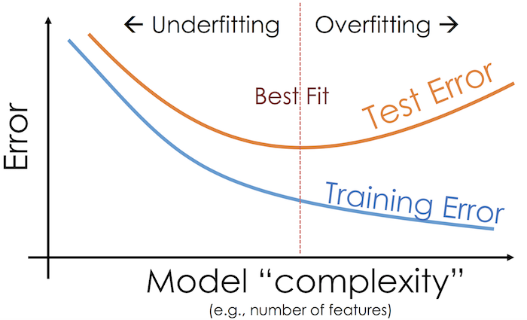
Training | Testing Error
Notes:
Underfitting: Model is not complex enough and not paying enough attention to the training dataset
Not powerful enough to capture the pattern
Overfitting: A model is too complex and paying too much attention to the training set and modeling the noise

Slide 21
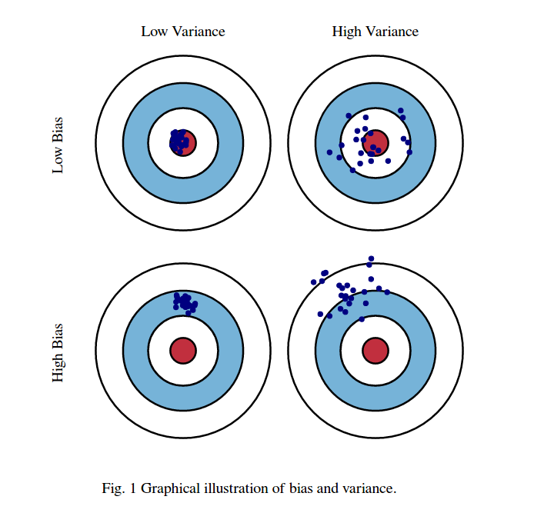
Training | Testing Error
Notes:
Generally we don’t know the true Bias and Variance Error
B/C we don’t have the population dataset we are trying to generalize about the population

Slide 22
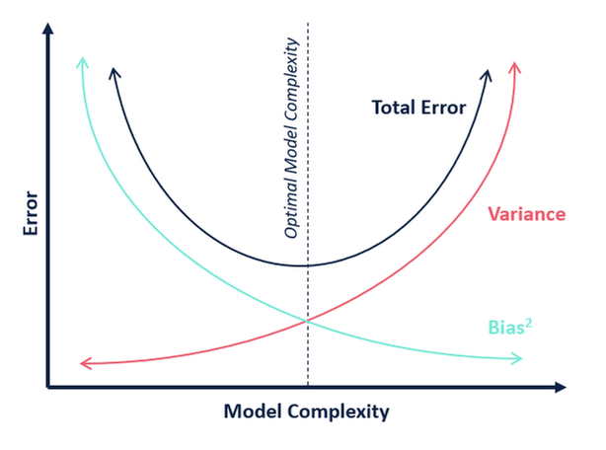
Bais-Variance Tradeoff
Notes:
Generally without the knowledge of the population data,
you cannot compute the exact Bias and Variance of a given mode

Slide 23
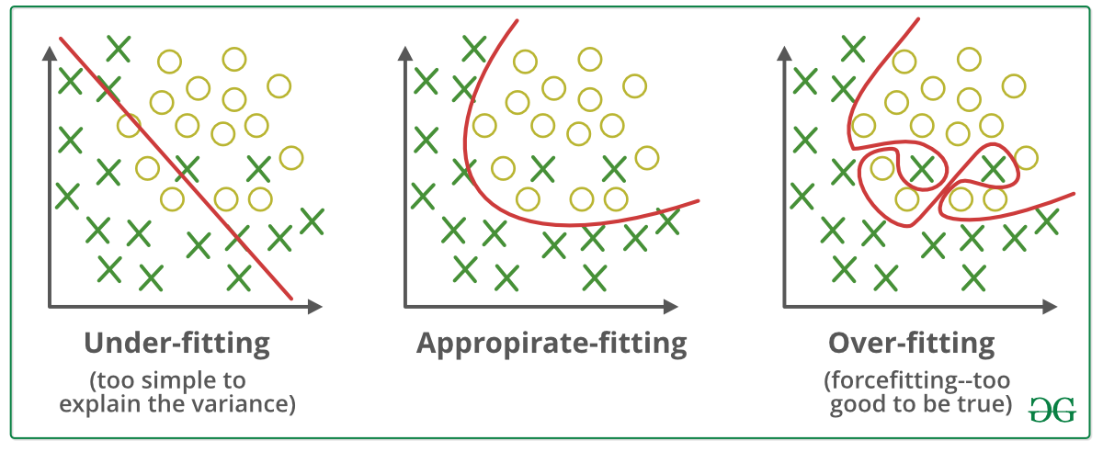
Overfitting | Underfitting
Notes:
Underfitting: Model is not complex enough and not paying enough attention to the training dataset
Not powerful enough to capture the pattern
High Biased Error
Use a more complex model | add more features |
Linear Regression | Logistic Regression
Overfitting: A model is too complex and paying too much attention to the training set and modeling the noise
High Variance Error
Less complex model | Remove features (Regularization | Dimensionality Reduction | PCA)

Slide 24
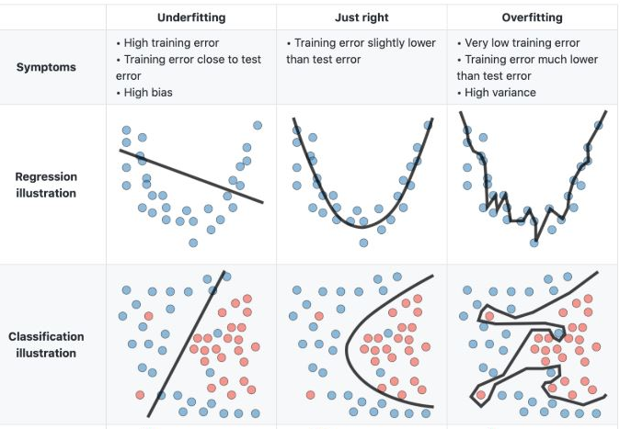
Overfitting | Underfitting
Notes:
Underfitting: Model is not complex enough and not paying enough attention to the training dataset
Not powerful enough to capture the pattern
High Biased Error
Use a more complex model | add more features |
Linear Regression | Logistic Regression
Overfitting: A model is too complex and paying too much attention to the training set and modeling the noise
High Variance Error
Less complex model | Remove features (Regularization | Dimensionality Reduction | PCA)

Slide 25
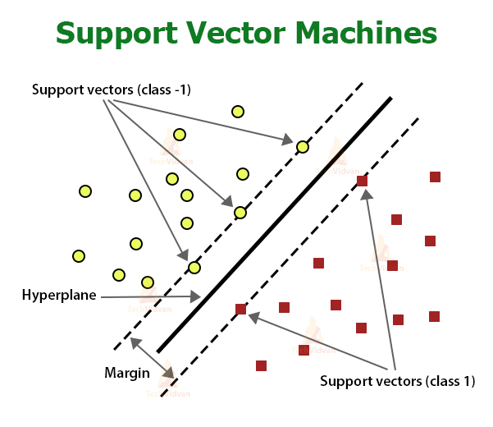
Supervised Training - SVM
Notes:
Classification by hyperplanes
Very powerful
Takes time to find optimal parameters
Works well with multi dimensional data
Works well with both linear and non-linear data
Can work with classification and regression (Not interpretable)
Very slow with larger datasets

Slide 26
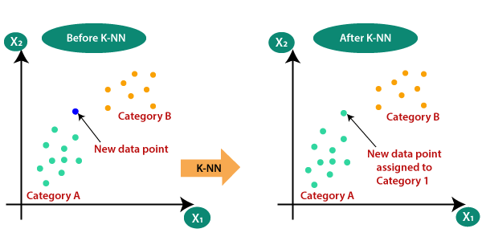
Supervised Training - KNN
K = 2
Notes:
When the classification results in a tie, there are no hard rules set in stone
Very naïve, always best to use odd K-Values
Algorithm that looks at the nearest points and based on the votes determines what classification of that point

Slide 27
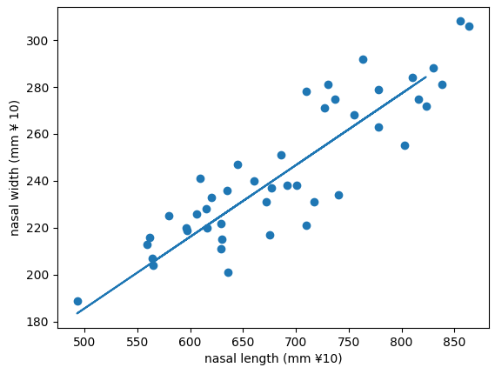
Supervised Training – Linear Regression

Slide 28
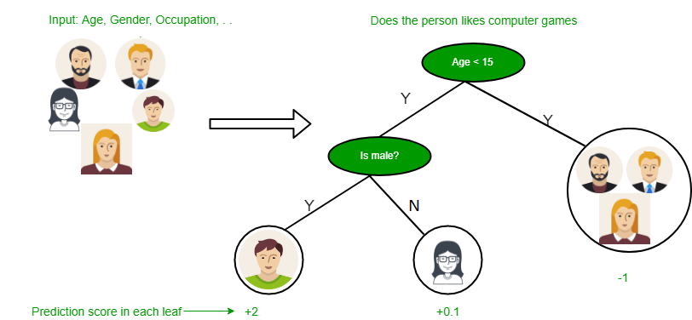
Supervised Training – Decision Tree
Notes:
Flowchart like model
Each internal node represents a feature and each leaf node represents a class label
Splits based on the impurity of the data at each node: Highest information gain
Can easily overfit, but Interpretable
Random Forest (Bagging) not interpretable (black box)
XG Boosting (Boosting) not interpretable (black box)

Slide 29
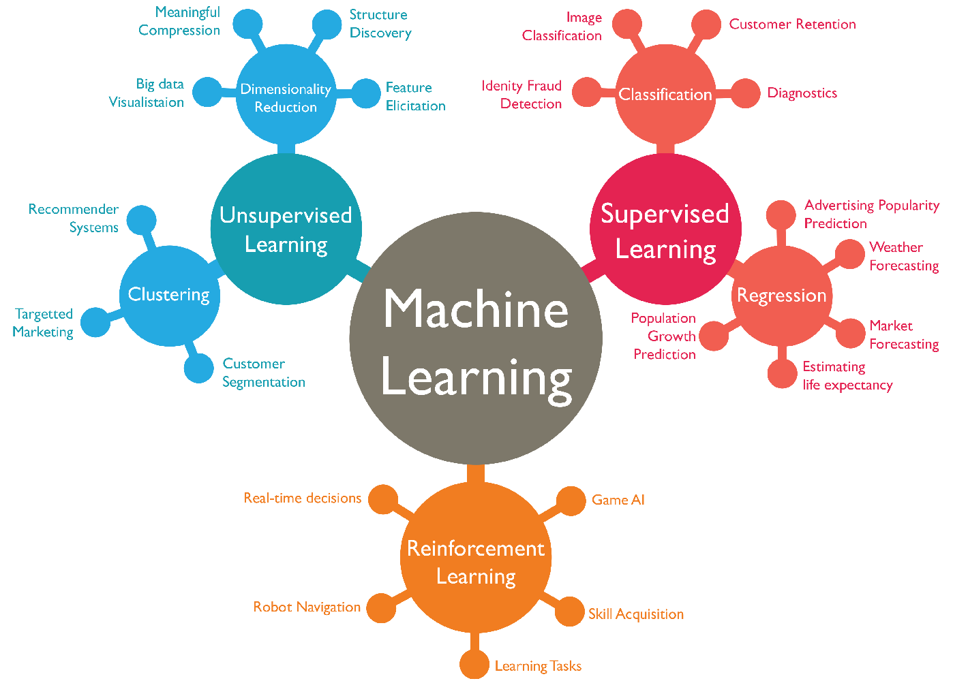
Wrap Up

Slide 30
Wrap Up
Please Note:
Data Scientist are NOT magical wizards
Even we have limitations 😏

Slide 31
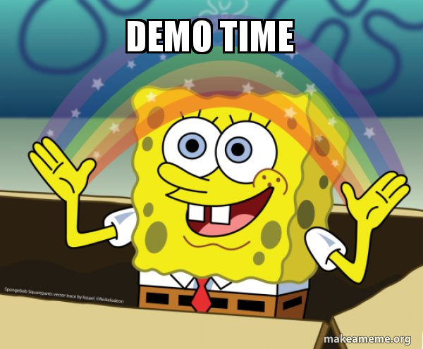
Demo

Slide 32
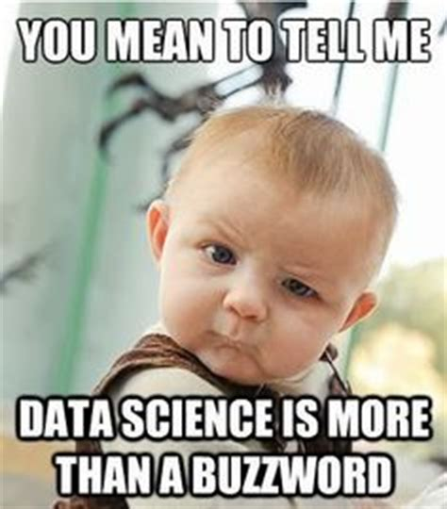
Wrap Up
Questions?😏
Notes:
Next Steps:
SVM Hyperparameter Tuning: https://towardsdatascience.com/support-vector-machine-simply-explained-fee28eba5496

